Slide 1
Initial data analysis for HTT competitors and internal compounds
March 4, 2022
Zhen, Dann, Cherine, Joon, Magnus, Jessica

Slide 2
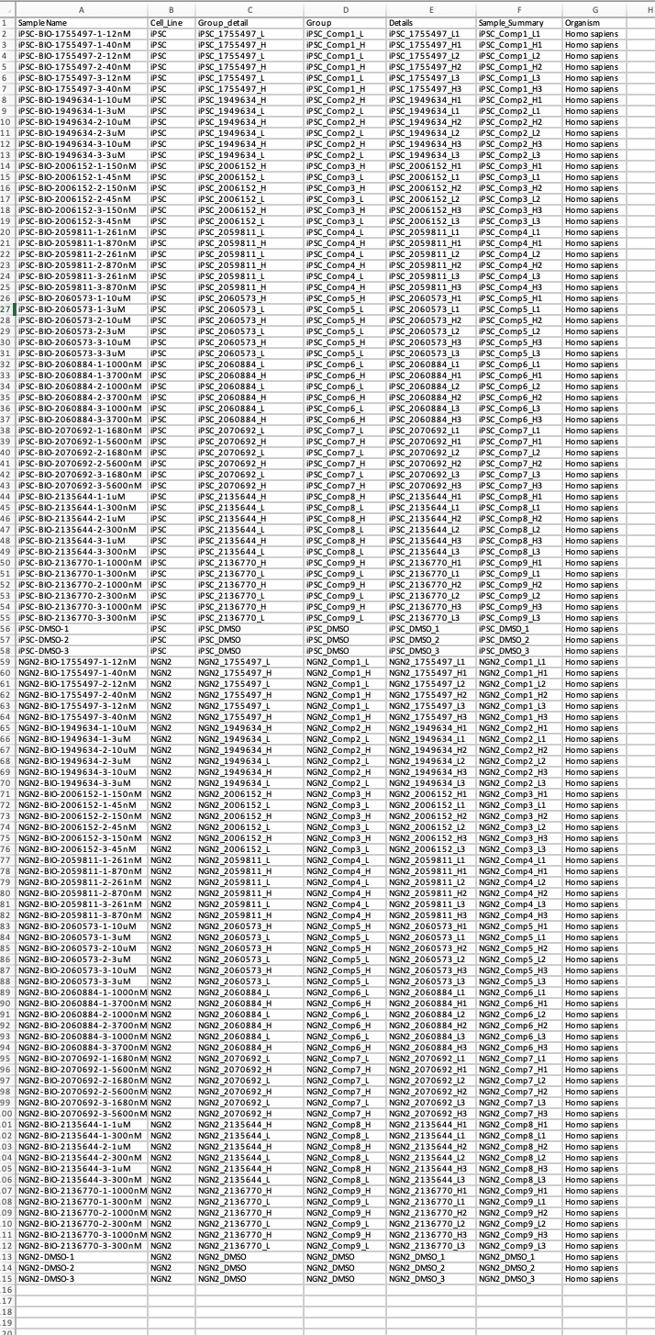
Study design
Cell lines:
iPSCs (DIV ?)
NGN2 (DIV14)
(same individual)
Treatment:
24hr
Replicates:
3 biological
Total Samples:
114

Slide 3
Sample similarity from Gene Expression
PCA in 2D
PCA in 3D

Slide 4
Sample similarity from Gene Expression
PCA in 2D for iPSC
PCA in 2D for NGN2

Slide 5
Sample similarity from Gene Expression
Expression heatmap for iPSC
Expression heatmap for NGN2

Slide 6
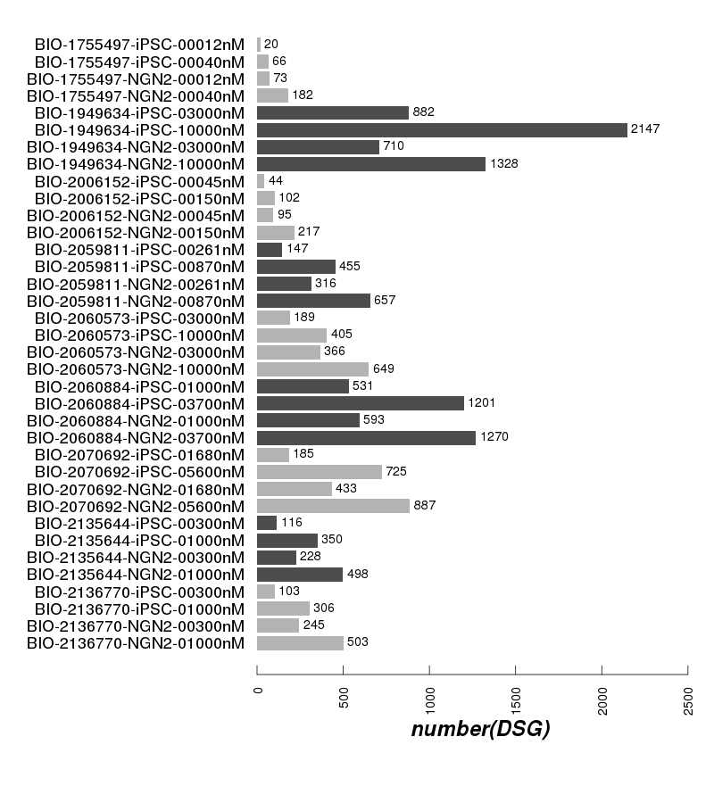
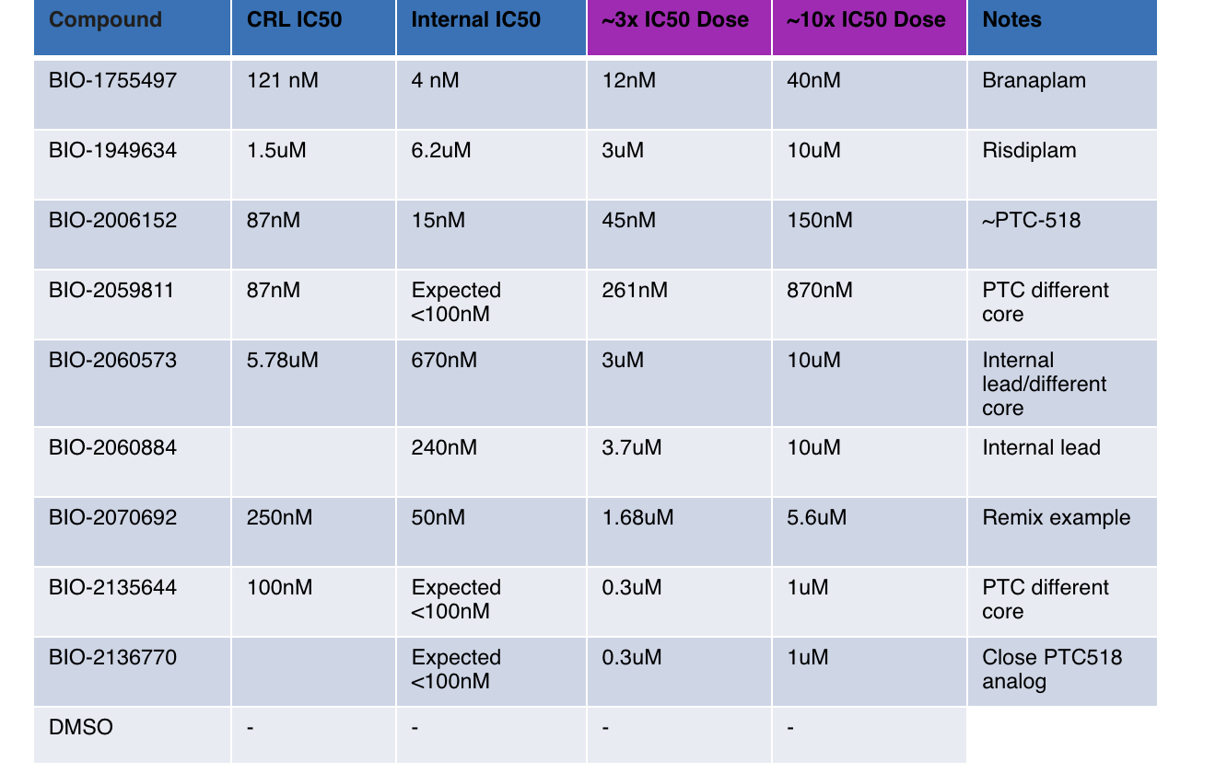
DSG numbers

Slide 7
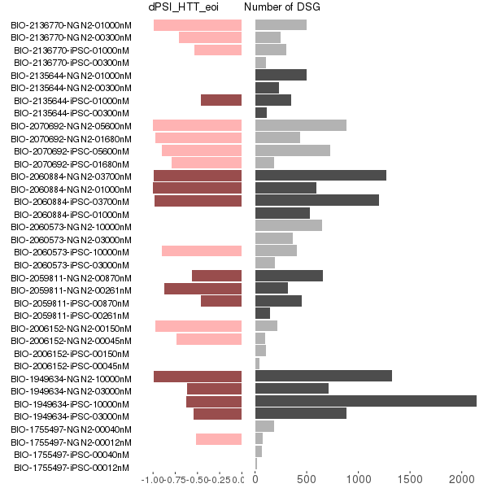
DSG and dPSI in eoi

Slide 8
Sample similarity from Gene Expression

